Slide 1



Using meditation rooms to attract talent.
Marie Vrablic – Data Analyst
www.linkedin.com/in/marievrablic-dat-a-girl

Slide 2
“Meditation is like a gym in which you develop the powerful mental muscles of calm and insight.” – Ajahn Brahm
This data comes from a Global Survey performed from www.Authentic-Happiness.com.
This website is a free website dedicated to helping people achieve greater life satisfaction through "Positive Psychology, intentional activities, and weekly habits".
The results of this survey is from July 7, 2015 to December 31, 2018.
Data Set from Yvon Dalat, Kaggle.com
Notes:
First, we will look at what the Dept. of Health and Human Services has to say about the growing trend in mindfulness.

Slide 3
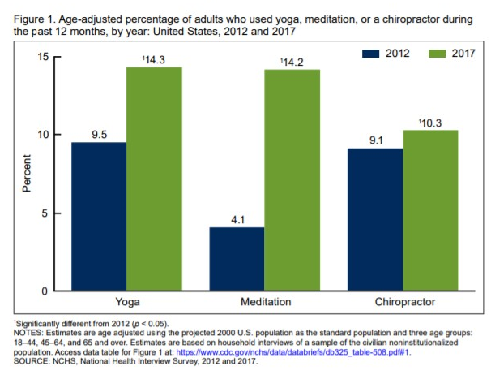
‘Meditation is identified as the fastest-growing trend, seeing a more than threefold leap in users. In 2012, 4.1% reported using meditation, and in 2017, that increased to 14.2%.’¹ Meditation helps you navigate stress. Regular mindfulness practice improves mental focus. Having a dedicated spot for meditation may help attract talent to the company and increase production.
Notes:
The CDC did a study in 2017 that showed alternative treatments to mental wellness growing at a high rate; meditation being the fastest growing method. While CDC looked at growing trends in yoga, meditation, and Chiropractic care, we will be looking at just meditation rates and it’s effect on production.

Slide 4
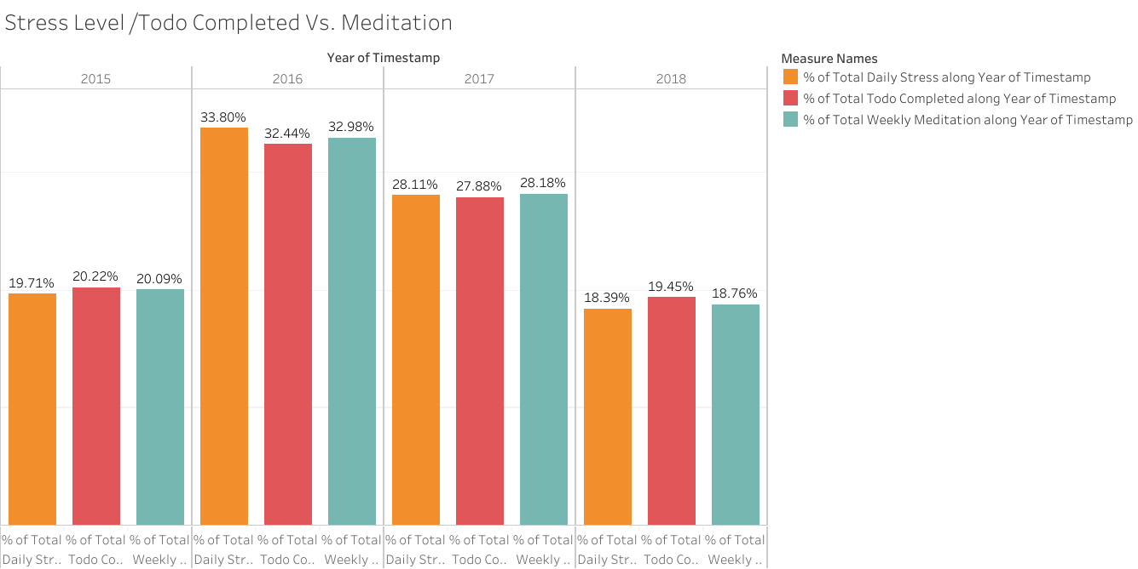
‘Todo Completed’, in this study, is defined as how well do you complete your weekly todo list. As expected, the graph shows that much of the stress level and Todo completed are at the same level. A closer look shows that as the stress level gets higher (33.8% and 28.11%), like that in 2016 and 2017, the ability to complete the Todo list (32.4% and 27.9%) is a little lower. However, the weekly meditation stays within 2% of the stress level and Todo list completed throughout the 4 years.
Notes:
Looking at the graph, we can see as “Total ToDo Completed” and “Daily Stress” rise and fall through the four year period, the “Weekly Meditation” rate stays in line with those rises and falls. So as you might expect, the more stressed people are, the more they meditation, and vice versa; 2016 being the most stressful year, perhaps due to the election and political turmoil We will next look at the breakdown in meditation rates by age.

Slide 5
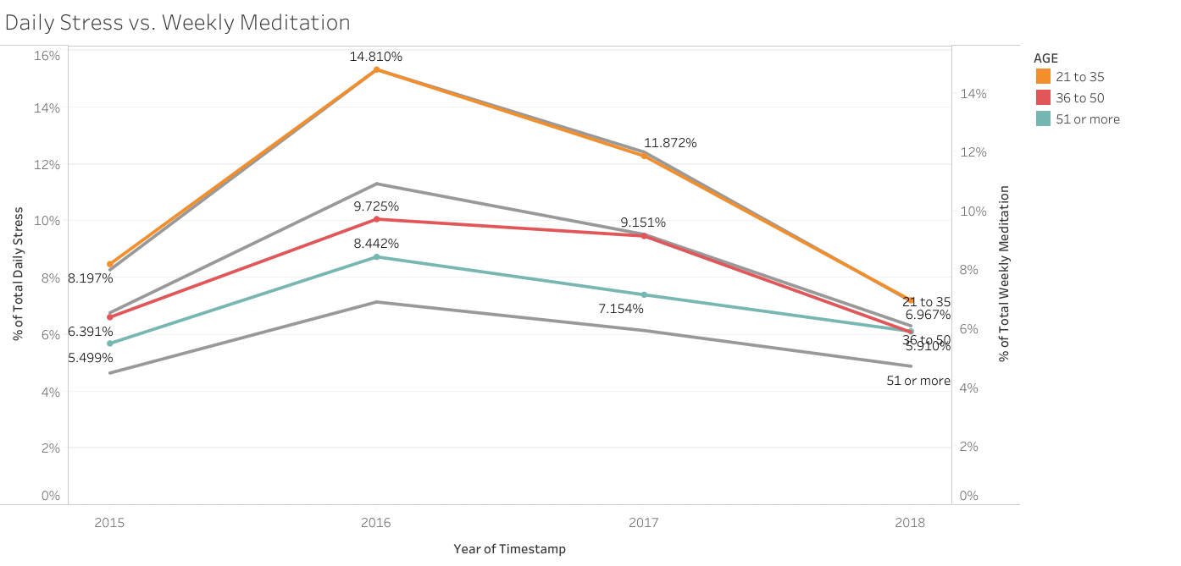
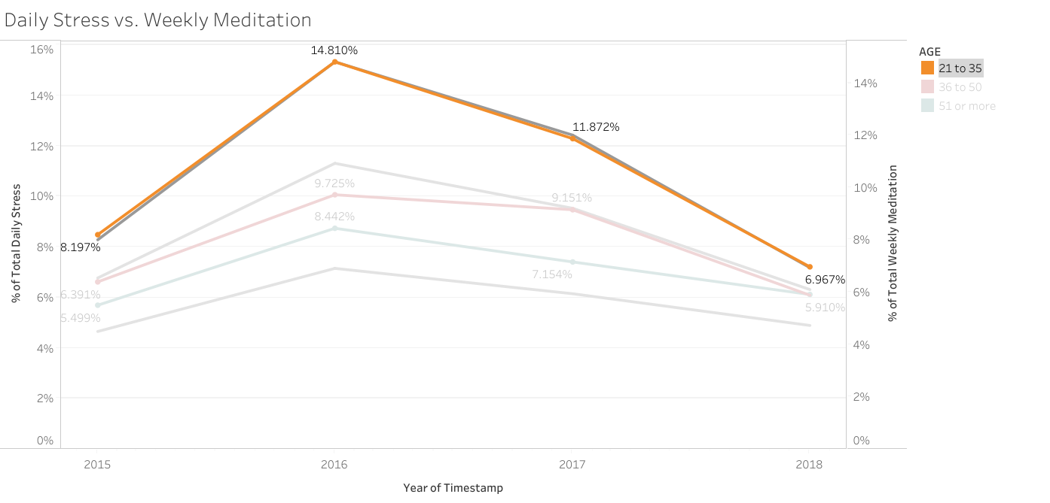
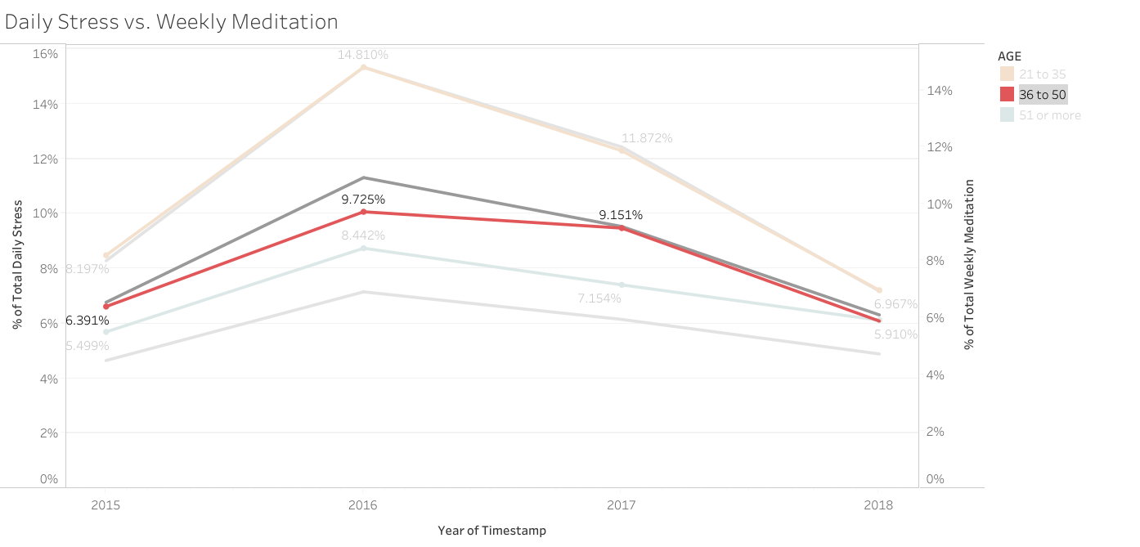
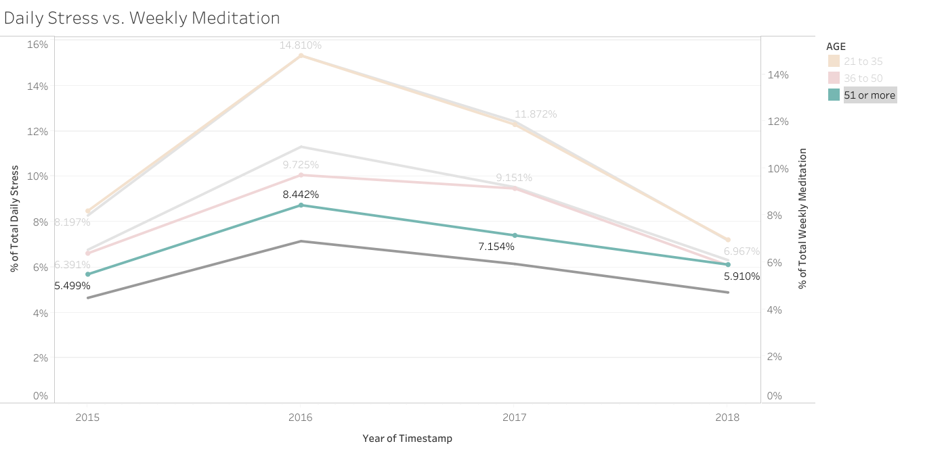
The breakdown by age tells us that the weekly meditation rates among 21-35 year-olds stays in line with their stress level, with the stress level and meditation rates of this age group being the highest (15.3%). Those ages 36-50 tend to meditate less (9.7%) as stress increases (11.3% max). The age group of 51+ meditates more (8.4%) perhaps reducing their stress level by 1.3%.
Notes:
Breaking down the data further, we can see that those ages 21 to 35 have the most stress, perhaps because they are starting their careers and working hard to improve to move ahead. Allowing them meditation space would give this group an outlet to better focus and have a better work-life balance, and perhaps attracting new talent to the company. Alternatively, allowing a space for 51+ veteran team members would allow them to keep stress low while improving mental focus, and attracting senior level talent to the company.

Slide 6
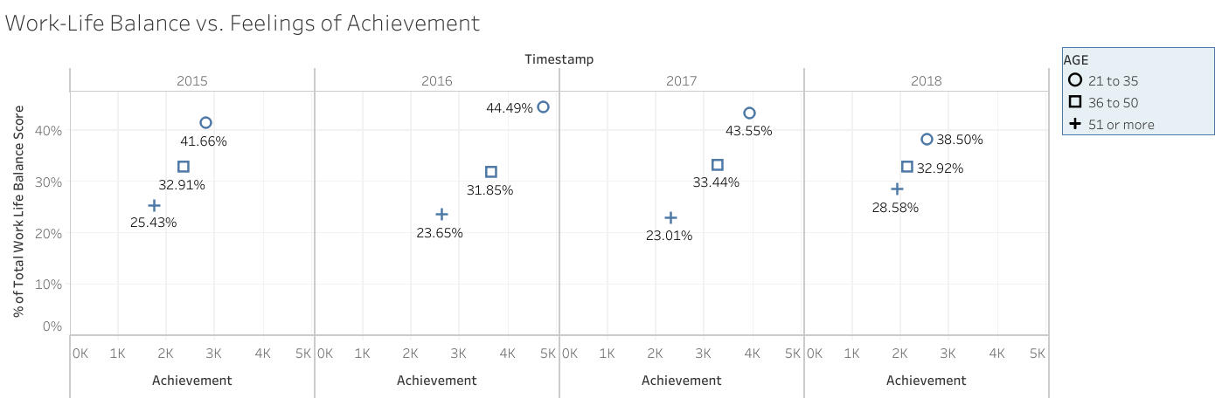
Meditation is related to work-life balance. For age group 21-35, the more work-life balance they have, the greater feeling of achievement (45% in 2016). This is also they same group meditates the most, but still has the highest stress level. Allowing time for meditation would create a better work-life balance, in turn creating a better sense of accomplishment, happiness in the company, and attracting talent.
Notes:
This graphic shows that the more employees achieve, the more the feel they have a work-life balance.
These two themes are positively correlated, and stand out most amongst the 21-35 age group, where these employees can grow and achieve the most in their careers.
Interestingly enough, 2016 was the most stressful year, but we see here that it also has created the greatest sense of achievement for the lowest age group.

Slide 7
Next Steps
Survey employees on how they view meditation rooms and what they would like to have in a meditation space.
Cost analysis on converting an office to meditation space.
Notes:
With the growing trend of alternative medicine, it would be beneficial to look into a low cost way to allow meditation rooms to improve mental focus and wellbeing.
While this is still a new topic, it would be in the best interest of the company to see how employees feel about the topic.

Slide 8
“Meditation is like a gym in which you develop the powerful mental muscles of calm and insight.” – Ajahn Brahm
In conclusion, providing a meditation space in office allows team members a way to destress, calm the mind, and provide better focus on project.
Meditation rooms can be a low-cost way to attract new and experienced talent in creating a well-balanced work-life lifestyle.
TABLEAU ANALYSIS

